Slide 1

THE EARTHWORM
THE PERIODIC NEWSLETTER OF THE WINDSOR (CT) GARDEN CLUB
CELEBRATING 81 YEARS OF CONTINUOUS EXISTENCE
Co-Presidents: Debbie Baker and Patty Crowley
Co-Vice Presidents: Florence Barlow and Maureen Vagnini
Recording Secretary: Laurie Durant
Treasurer: Lieba Bernstein
Corresponding Secretary: Erin Bourdon
Immediate Past President: Diane Bernier
Earthworm Editor: Jim Bennett
WORDS FROM THE CO-PRESIDENTS
We're looking forward to serving the Windsor Garden Club this year. We enjoyed the summer meetings that gave a great opportunity to get to know other people better, as well as the chance to see the handiwork of members and their beautiful gardens.
Maureen Vagnini and Flo Barlow have done an outstanding job preparing this year's speakers as well as several fall outings with more in the planning stages for spring - mark your calendars so that you don't miss out!
We hope that members will choose to participate in a variety of ways this year, from attending meetings and outings to volunteering for hospitality items, committees, and civic endeavors.
Ideas are always welcome, and we will include on meeting agendas for further discussion. We encourage you to get in touch with questions at any time (well, probably not 11pm-6am) and to spend time getting to know people this year.
Patty Crowley and Debbie Baker

Slide 2


BASIC CLUB MEETING INFORMATION
Business meetings are typically held at the Windsor Senior Center,
599 Matianuck Avenue in Windsor.
Meetings during September, October, November, March and April feature guest speakers. Social hour begins at 6:30 PM and the guest speaker begins their presentation at 7:00 PM. The Club conducts its business portion of the meeting after the guest speaker has finished. These meetings are free to anyone attending.
The December meeting is a member only meeting during which Club members construct holiday wreaths.
The February meeting is the annual “soup talk” meeting where members bring soups and breads to share. During this meeting there is a round-table discussion of plant and horticulture related topics.
The May meeting is a member only meeting during which final plans are made for the annual Garden Mart plant sale. Also, attending members can participate in a plant swap.
There is no Club meeting in January.
Meetings during June, July and August are deemed to be only social meetings. These three meetings are typically held at the respective homes of Club members.
SHORT TERM FUTURE CLUB EVENT
September 10, 2018 – This is the Club’s initial business meeting for the 2018-2019 session of the Club. Guest speaker for this meeting will be Ms. Cathy Wolko. Cathy is known as “The Bee Lady”.
Cathy will be talking to us about Beekeeping, why and how she became a Beekeeper. Learn how she started keeping honey bees. Learn about The Great American Beekeeper Lorenzo Langstroth and his famous Langstroth hive. Learn about equipment and the tools needed to be a Beekeeper. She will provide valuable resources for beekeepers of all stages.
Cathy states that 75 percent of the flowering plants on Earth rely on some degree of pollination in order to set seed or fruit. She will talk to us about pollinator syndromes, convergent evolution, the benefits to protecting our pollinators, value vs loss, a look at endangered species and a discussion on commercial pollination.

Slide 3

SHORT TERM FUTURE CLUB EVENT
October 6, 2018 – The Club will be staffing an information booth during the Lion’s Club annual fall craft fair. Members are asked to consider staffing the booth in an effort to promote the Club. A sign-up roster will be available during the September meeting. The booth will be located on the Town Green (Broad Street).
FUTURE EVENTS CALENDAR
DATE | EVENT
October 6, 2018 | Information Booth at the Lion’s Club craft fair
October 15, 2018 | October 2018 business meeting with guest speaker
November 12, 2018 | November 2018 business meeting with guest speaker
December 10, 2018 | December 2018 business meeting – wreath construction event
December 16, 2018 | Holiday luncheon – location to be determined
February 11, 2019 | February 2019 business meeting – “Soup Talk”
March 11, 2019 | March 2019 business meeting with guest speaker
April 8, 2019 | April 2019 business meeting with guest speaker
May 13, 2019 | May 2019 business meeting – member plant swap
May 18, 2019 | 2019 Garden Mart fundraising event on the Town Green
June 10, 2019 | June 2019 summer social meeting
July 8, 2019 | July 2019 summer social meeting
July 13, 2019 | 2019 Garden Tour fundraising event titled: “A Midsummer Gardeners’ Dream”
August 12, 2019 | August 2019 summer social meeting
As the date of an event draws closer, more detailed information will be provided in upcoming issues of the EARTHWORM.

Slide 4

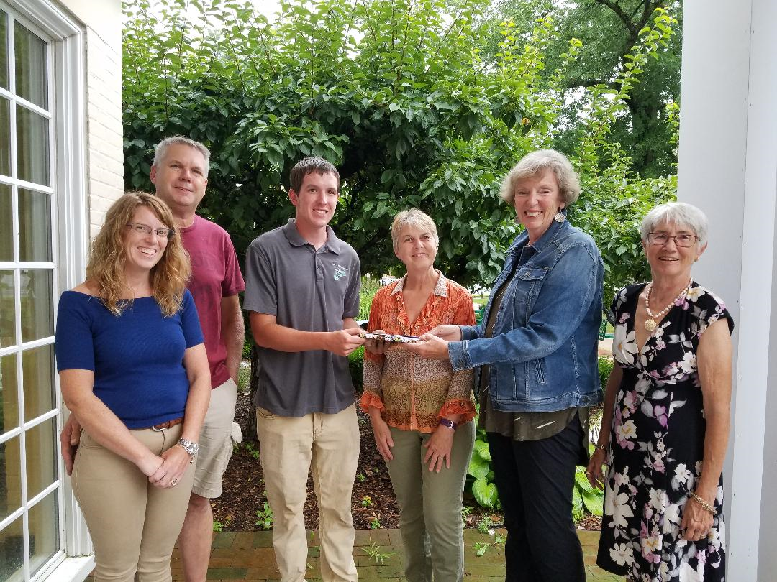
RECENT CLUB EVENT – 2018 SCHOLARSHIP AWARD
On Monday, August 13th, representatives of the Windsor Garden Club, presented the Club’s annual scholarship award to Mr. Christopher Dowd. Christopher will be attending the University of Connecticut. His planned studies will be within the landscape architecture program.
Pictured with Christopher (left to right) are his parents, Colleen and Daniel Dowd, Rose Stepnick (WGC Scholarship Committee), Cindy Daniels (past WGC Vice-President), and Laura Jary (past WGC President)

Slide 5

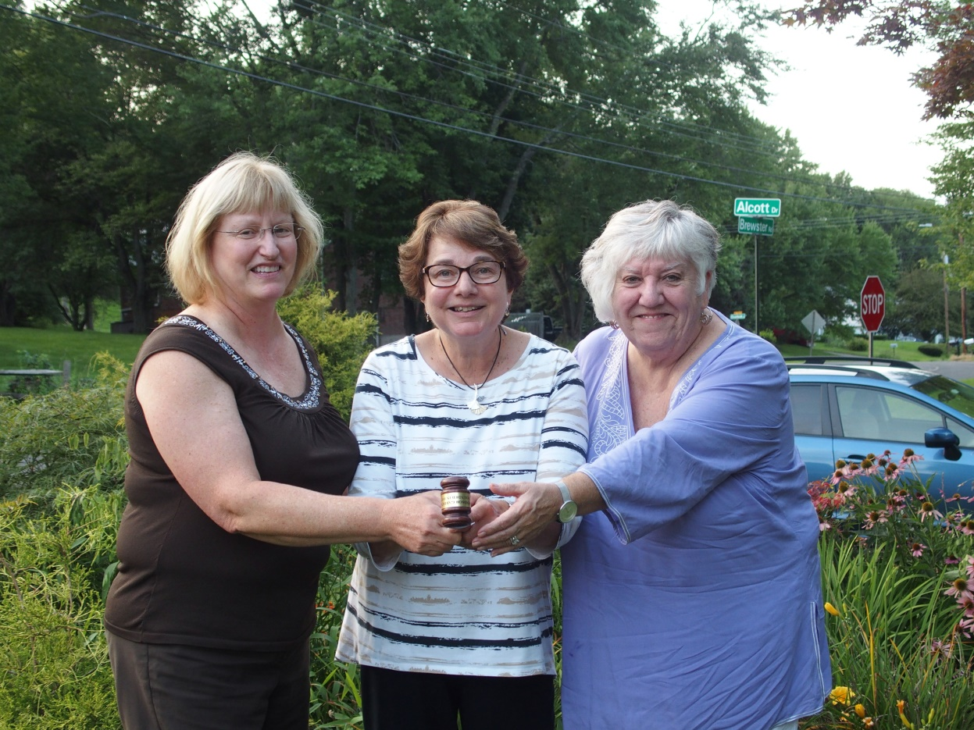
RECENT CLUB EVENT – TRANSFER OF THE PRESIDENT’S GAVEL
On Monday, August 20th, during the August social meeting of the Club, outgoing President, Diane Bernier, transferred the Club’s presidential gavel to the incoming Co-Presidents, Debbie Baker and Patty Crowley. Thank you to Diane for her past and continuing service to the Club. Also, thank you to Debbie and Patty for their future service to the Club.
Pictured (left to right) are Debbie Baker, Diane Bernier and Patty Crowley

Slide 6

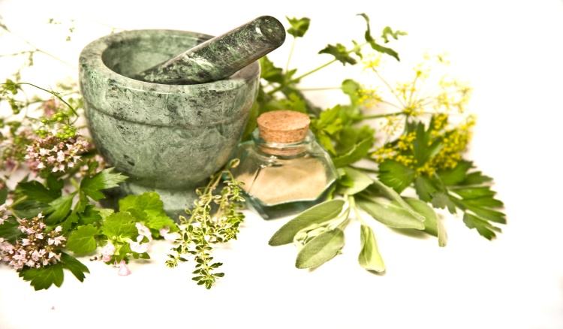
CLUB COMMITTEE INFORMATION
Hospitality Committee co-chairwomen Joan Lynch and Wendy Mitchell announce that refreshment sign up sheets will be circulated during the September meeting. Everyone is urged to consider assisting the committee at least once!
Also, the Club’s Board of Directors will be providing refreshment items for the September meeting.
The next scheduled Club effort to maintain and enlarge the herb garden at the Windsor Historical Society facility, will be Saturday, September 29th. The start time will be 9:30 AM. If you can assist with this activity, please contact Cindy Daniels. With many hands helping, only 2 hours should be necessary to complete all necessary tasks!

Slide 7


CLUB MEMBERSHIP INFORMATION
Club membership is open to anyone who has an interest in plants, landscaping, horticulture and other related topics. Annual membership dues are $20.00 for an individual and $35.00 for a family. Renewal memberships are typically due June 1st while new memberships are accepted at any time. The current membership application form is available on the Club’s website.
WWW.WINDSORGARDENCLUBCT.ORG
REQUESTING ASSISTANCE FROM THE CLUB
The members of the Windsor Garden Club are able and willing to provide both the design and installation of landscape beautification projects within Windsor. If you would like additional information about obtaining the Club’s assistance, please download the information document and application form from the Club’s website. (Word and PDF formats are available.)
WWW.WINDSORGARDENCLUBCT.ORG

